Slide 1
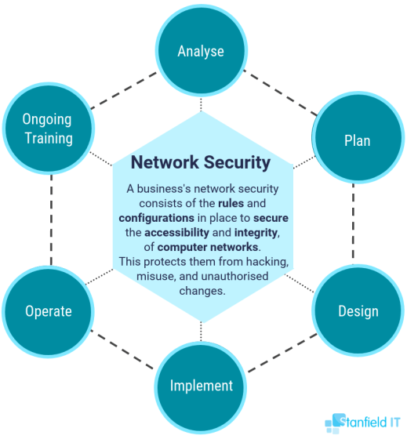
Chapter 6: Network Security

Slide 2
Chapter Overview
Introduction
Viruses, worms, and Trojan horses
Phreaks and hackers أصحاب النزوات
Denial-of-service attacks
Online voting

Slide 3
Introduction
Computers getting faster and less expensive
The utility of computers increasing
Email
Web surfing
Shopping
Managing personal information
Increasing use of computers → growing importance of computer security

Slide 4
Viruses
Virus: piece of self-replicating code embedded within another program (host)
Viruses associated with program files
Hard disks, floppy disks, CD-ROMS
Email attachments
How viruses spread
Diskettes or CDs
Email
Files downloaded from Internet
Viruses today
Commercial antivirus software
Few people keep up-to-date

Slide 5
Worms
Worm
Self-contained program (send by social engineering)
Spreads through a computer network
Exploits security holes in networked computers استغلال
Famous worms
WANK
Code Red
Sapphire (Slammer) الياقوت
Blaster
Sasser

Slide 6
The Internet Worm
Robert Tappan Morris, Jr.
Graduate student at Cornell
Released worm onto Internet from MIT computer
Effect of worm
Spread to 6,000 Unix computers
Infected computers kept crashing or became unresponsive تعطل وعدم استجابة
Took a day for fixes to be published
Impact on Morris
Suspended from Cornell طرد من الجامعة
3 years’ probation + 400 hours community service
$150,000 in legal fees and fines
3 سنوات تحت المراقبة + 400 ساعة خدمة المجتمع
150 ألف دولار رسوم قانونية وغرامات

Slide 7
Ethical Evaluation
Kantian evaluation
Morris used others by gaining access to their computers without permission
Social contract theory evaluation
Morris violated property rights of organizations
انتهك موريس حقوق ملكية المنظمات
Utilitarian evaluation
Benefits: Organizations learned of security errors
Harms: Time spent by those fighting worm, unavailable computers, disrupted network traffic تعطل حركة النت , Morris’s punishments
Morris was wrong to have released the Internet worm

Slide 8
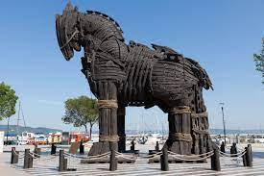
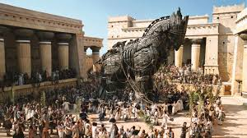
Trojan Horses
Trojan horse: program with benign حميدة capability that masks a sinisterشرير purpose. They do not replicate themselves.
Remote access Trojan (RAT): Trojan horse that gives attack access to victim’s computer.
RAT servers are often found within files downloaded from block Usenet sites.
provide the attacker with complete control of the victim's system.
Attackers usually hide these Trojan horses in games and other small programs that users then execute on their PCs.

Slide 9
Bot Networks
Bot: A software program that responds to commands from a program on another computer
Some bots support legitimate activities
Internet live Chat.
Multiplayer Internet games
Other bots support illegitimate activities
Distributing spam
Collecting person information for ID theft
Distributed denial-of-service attacks

Slide 10
Defensive Measures
System administrators play key role
Authorization: determining that a user has permission to perform a particular action.الصلاحيات
Authentication: determining that people are who they claim to be.مصادقة على الهوية
Firewall: a computer monitoring packets entering and leaving a local area network.
Ex: packet filter which accepts packets only from trusted computer on the Internet

Slide 11
Hackers
Original meaning (1950s)
Explorer
Risk-taker مجازفين
Technical virtuosoالموهوب التقني
Make a system do something never done before
Hacker Ethic
Hands-on imperative تدريب عملي
Access to computers that might teach you something about the work
Free exchange of information
Mistrust of authority---→ promote decentralization
Value skill above all else → not degrees, position مهارات فقط
Optimistic view of technology → computer can change your life to the better

Slide 12
Hackers قراصنة
Meaning of “hacker” changed
Movie War games
Teenagers accessing corporate or government computers by trying to get user names and passwords:
Dumpster diving قيادة متهورة : Looking through garbage for interesting bits of information
Social engineering: manipulation of a person inside an organization to gain access to confidential info.
الهندسة الاجتماعية: التلاعب بشخص داخل المنظمة للوصول إلى المعلومات السرية.
Modern use of hacking means ) Malicious( خبث وسرقة
Computer break-ins اقتحام
Destroying databases
Stealing confidential personal information
سرقة المعلومات الشخصية السرية

Slide 13
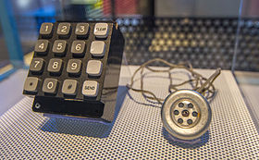
Phone Phreaking متلصص
Phone phreak: someone who manipulates the phone system to make free calls
Most popular methods
Steal long-distance telephone access codes
Guess long-distance telephone access codes
Use a “blue box” to get free access to long-distance lines --- mimic the actual frequency
Access codes posted on “pirate boards” by phreaks to share codes and credit card No.
تم نشر رموز الوصول على "لوحات القرصنة" بواسطة أشخاص لمشاركة الرموز وبطاقات الائتمان

Slide 14
Penalties for Hacking العقوبات
Examples of illegal activities
Accessing without authorization any Internet computer
Transmitting a virus or worm.
Trafficking in computer passwords. لاتجار بكلمات مرور الكمبيوتر
Intercepting a telephone conversation, email, or any other data transmission. اعتراض محادثة هاتفية أو بريد إلكتروني أو أي نقل بيانات آخر
Accessing stored email messages without authorization
Adopting another identity to carry out an illegal activity.
اعتماد هوية أخرى للقيام بنشاط غير قانوني.

Slide 15
Denial-of-Service Attacks
Denial-of-service attack: an intended مقصود action designed to prevent legitimate users from making use of a computer service
Goal of attack: disrupt يعطل a server’s ability to respond to its clients
About 4,000 Web sites attacked each week
Asymmetrical attack: a single person can harm a huge organization (multinational organization)
Asymmetrical attacks that may prove popular with terrorists
Ex: mafia boy2000 (amazon, yahoo, CNN, eBay, dell )

Slide 16
Motivation for Online Voting
2000 U.S. Presidential election closely contested
Florida pivotal state
Most Florida counties used keypunch voting machines
Two voting irregularities traced to these machines
2000 الانتخابات الرئاسية الأمريكية كان متنازع عليها بشدة
ولاية فلوريدا المحورية
استخدمت معظم مقاطعات فلوريدا آلات التصويت بالمفاتيح
مخالفتان في التصويت تم تتبعهما إلى هذه الآلات

Slide 17
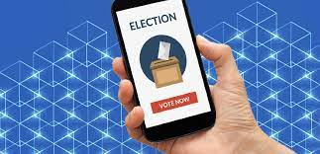

Benefits of Online Voting
More people would vote
Votes would be counted more quickly
No ambiguity with electronic votes
Cost less money
Eliminate ballot box tamperingإلغاء العبث بصناديق الاقتراع
Software can prevent accidental over-voting
Software can prevent under-voting (caused by poor ballot design).
يمكن للبرنامج منع التصويت المفرط العرضي
يمكن للبرنامج منع التصويت الناقص (الناتج عن سوء تصميم الاقتراع)

Slide 18

Risks of Online Voting
Gives an unfair advantage to those with home computers
More difficult to keep voter privacy
The system records the ballot as well as the identity of the voter
More opportunities for vote-selling
X: voter, y: candidate, z: broker who watch voting of x from his PC
The obvious target for a DDoS attackهدف واضح لهجوم
Security of election depends on the security of home computers
Redirected Susceptible to fake vote servers
phony server, getting credentials, then vote on your behalf from the actual site.
يتم إعادة توجيهك إلى خادم زائف ، والحصول على بيانات الاعتماد ، ثم التصويت نيابة عنك من الموقع الفعلي.
No paper copies of ballots for auditing or recounts.

Slide 19


